Slide 1
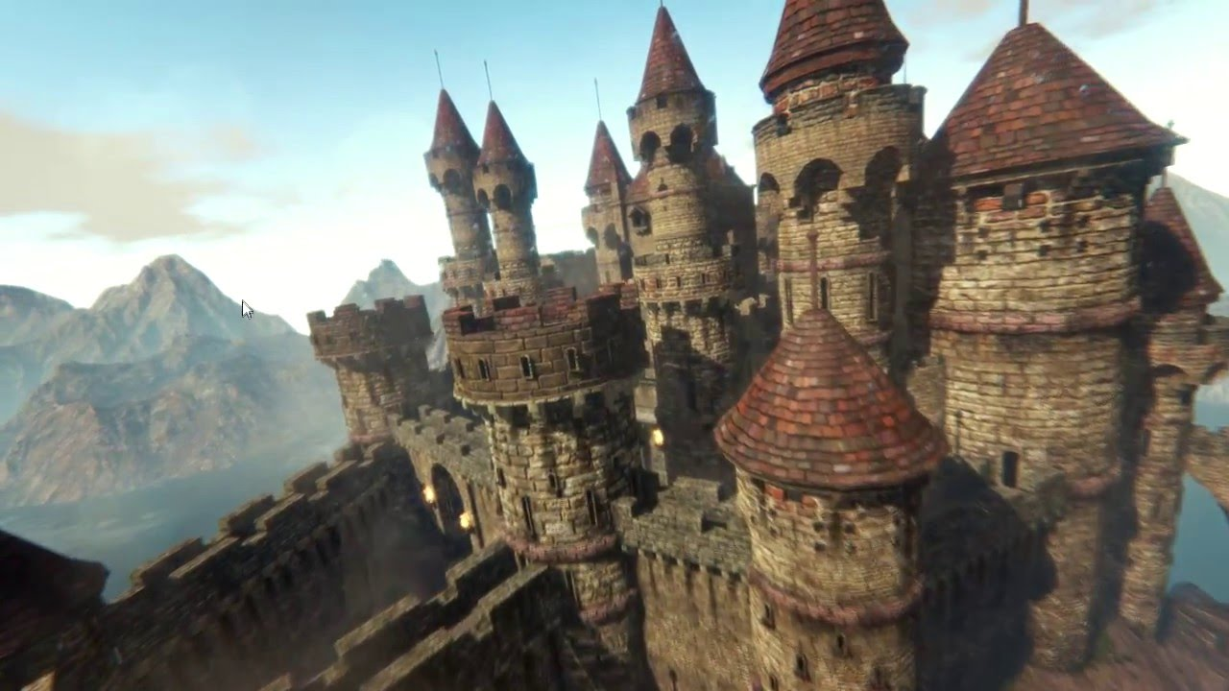
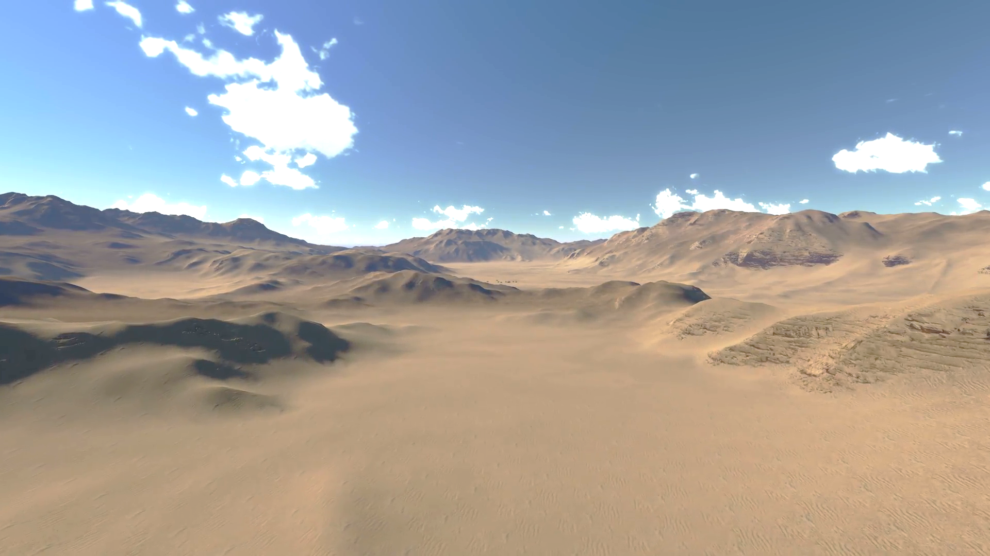
NOMAD UPRISING
VGDT CLASS
BY: AARON BISBAL
ACE DRAGONAIR
26/10/2018

Slide 2

Interesting Concept
exploration
TWO GAME PLAY MODES
player customizations
Unique landscapes
Unique battle mechanics

Slide 3

Regions
SWAMP
DESERT
WATERFALL
FOREST
MOUNTAIN

Slide 4
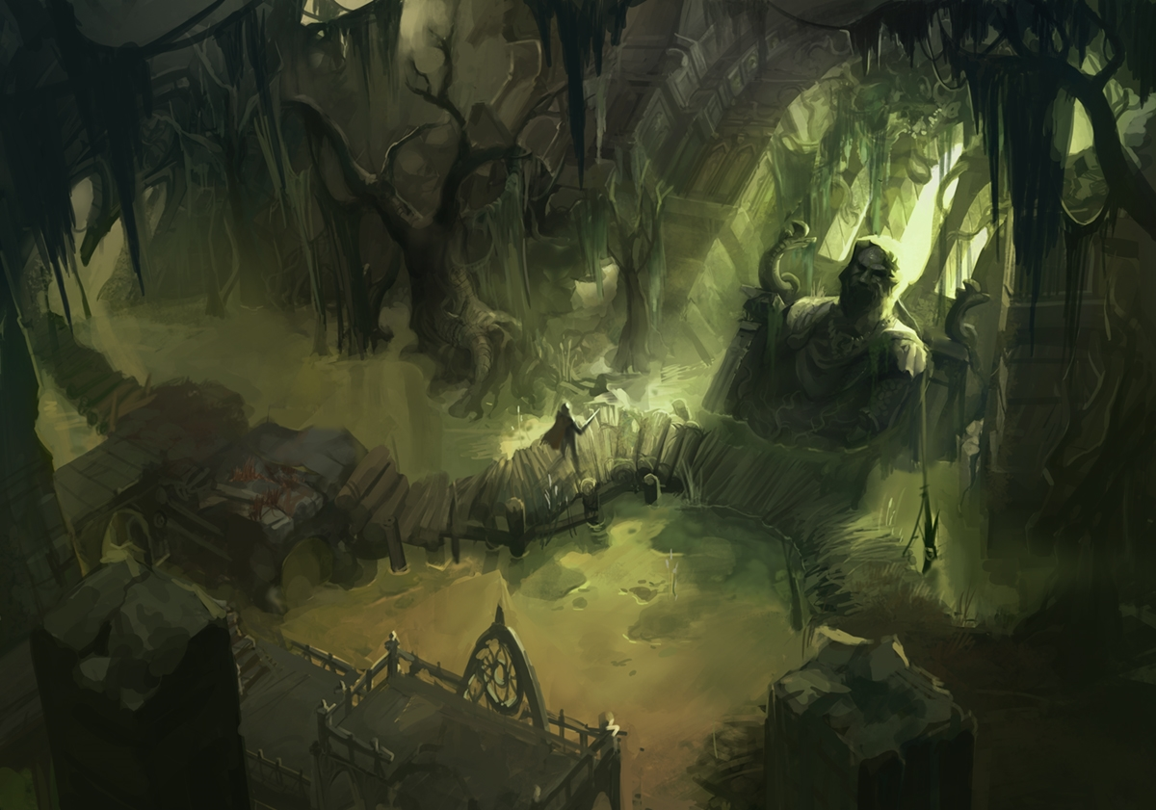
WASTELANDs
HOME TO THE Swamp nomads
Great source of toxic chemicals and poisons.
Hard to maneuver and covered with poisonous vapours

Slide 5

waterfall
Home to the water nomads
Great source of aquatic provisions, herbs, and water supply
Slippery to maneuver and Provide access to water transportation

Slide 6
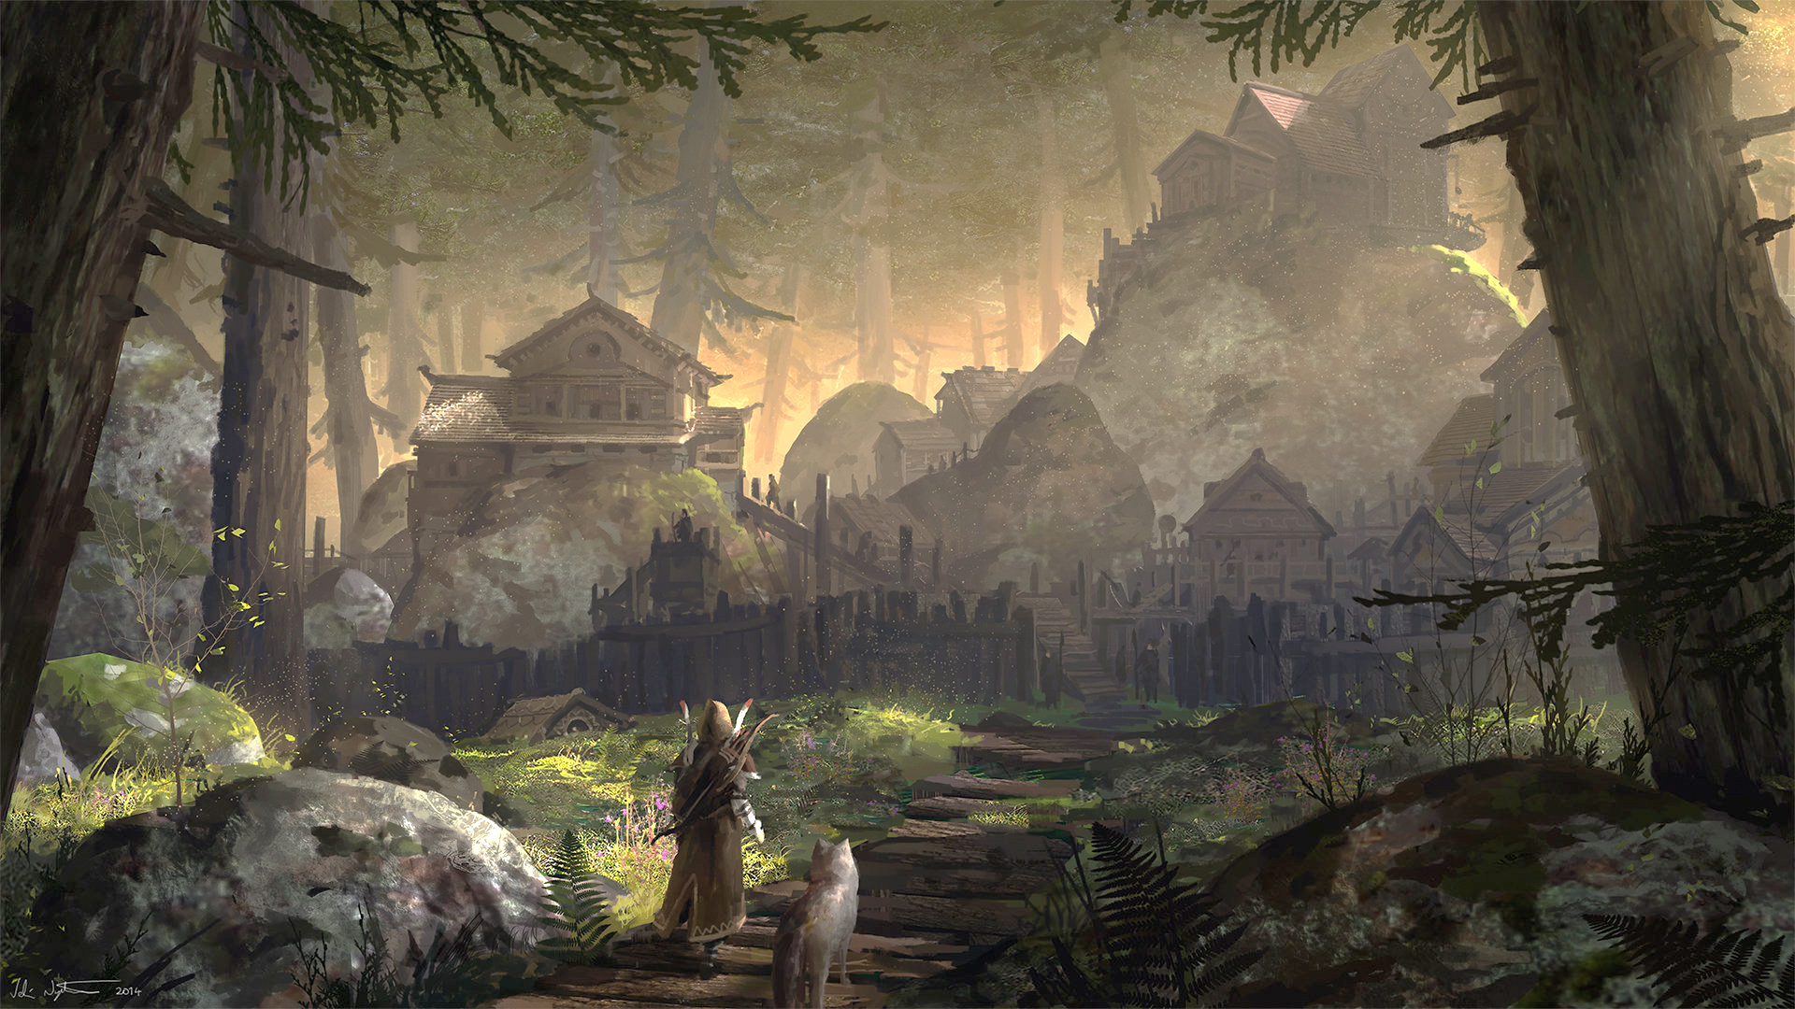
Forest
Home to the forest nomads
Great resource for wood and animal materials
Hidden in the forest and Provides cover from Aerial observation

Slide 7
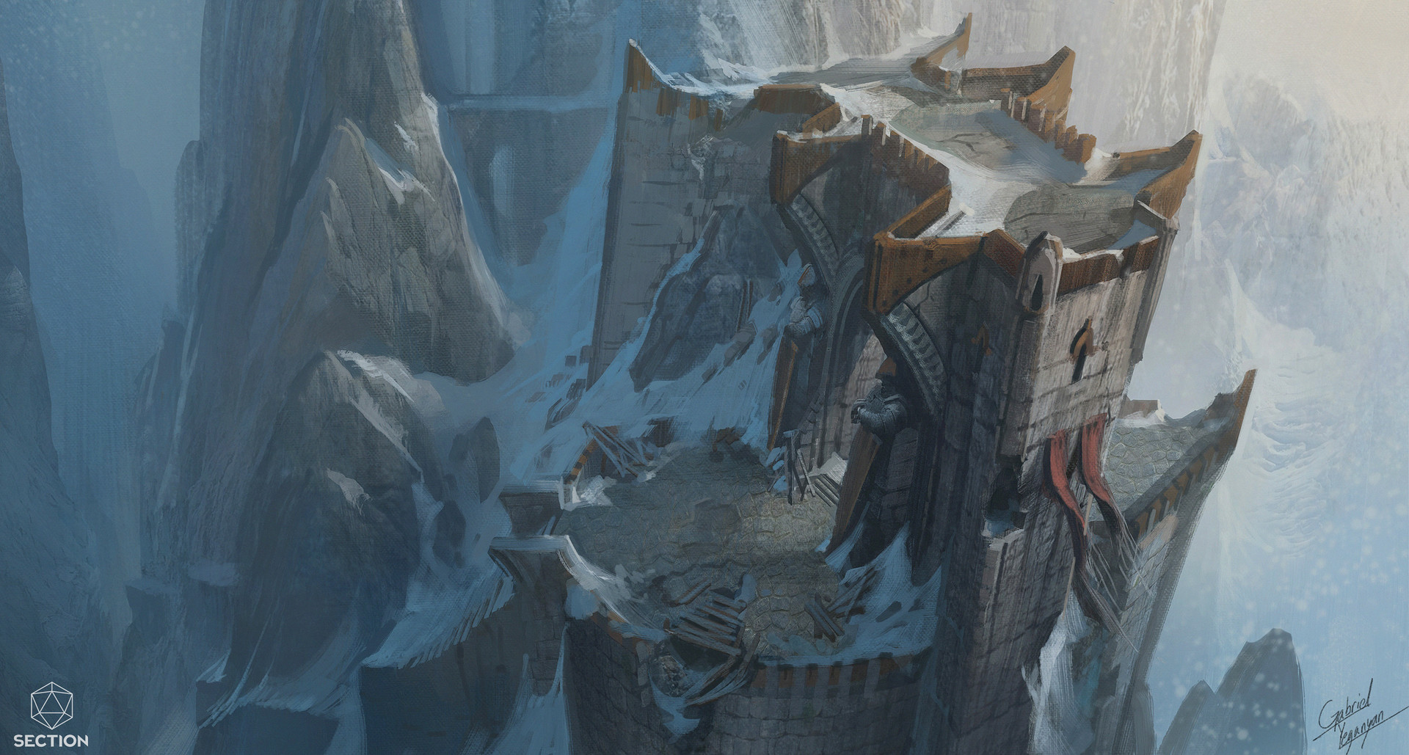
Mountain
Home to the mountain nomad
A great resource fore stones and minerals
Hard to access and Gives a great overview of the map

Slide 8
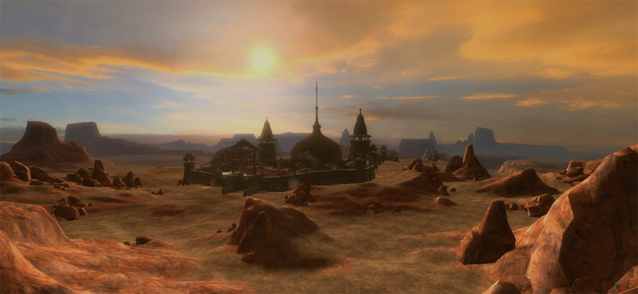
DESERT
Home to the desert nomads
Great supply of sediments
Isolated, camouflaged, and extreme heat conditions.

Slide 9
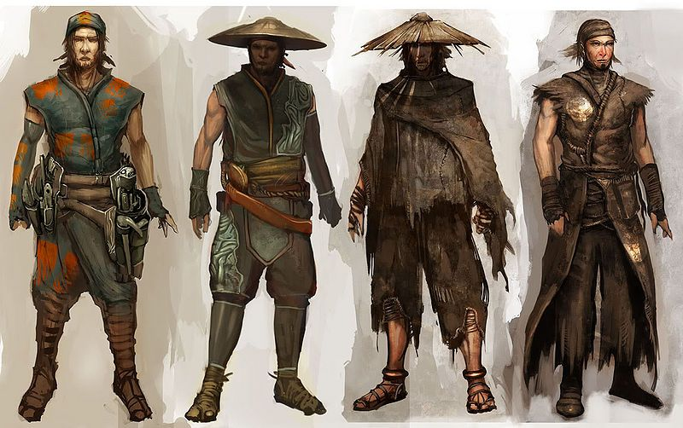
Character Customization

Slide 10
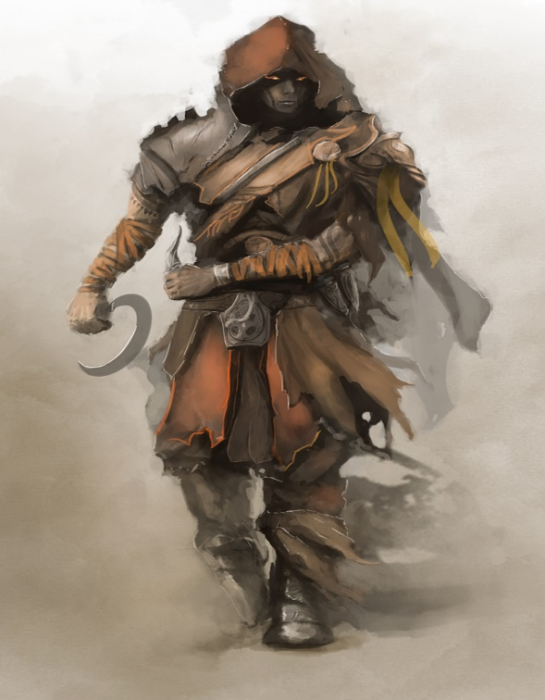
Clan
5 clan
race
10 races (Elves, human,
Goblin, etc.)
Power
3 main Combat power
Racial powers
Weapon power
Class power
others

Slide 11
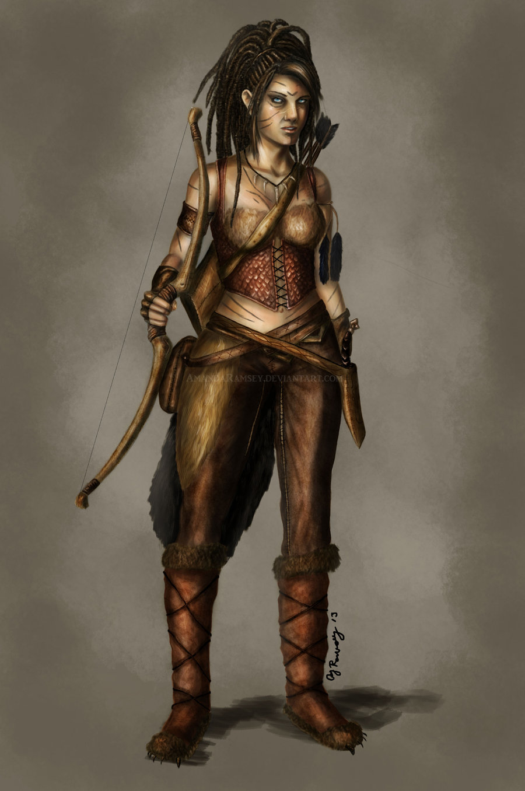
outfit
Colour
Abilities
Style (racial, material, clan, accessories. Etc.)
Body structure
Size (height)
Skin tone
Facial configuration
racial
Adornments
age

Slide 12

Story

Slide 13
a king who died leaving 5 successor each leading A region of their own.
Lead your group in combat as one of the clan
wage epic wars against the other clans
claim the throne and the kingdom

Slide 14
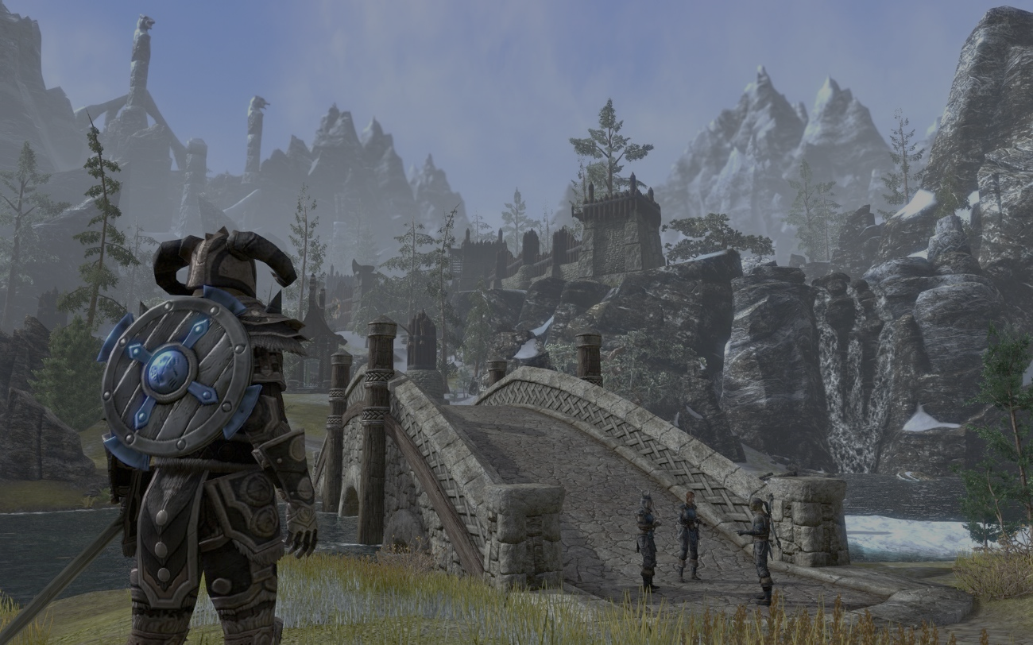
GAMEPLAY
Single player
ONLINE MULTIPLAYER

Slide 15
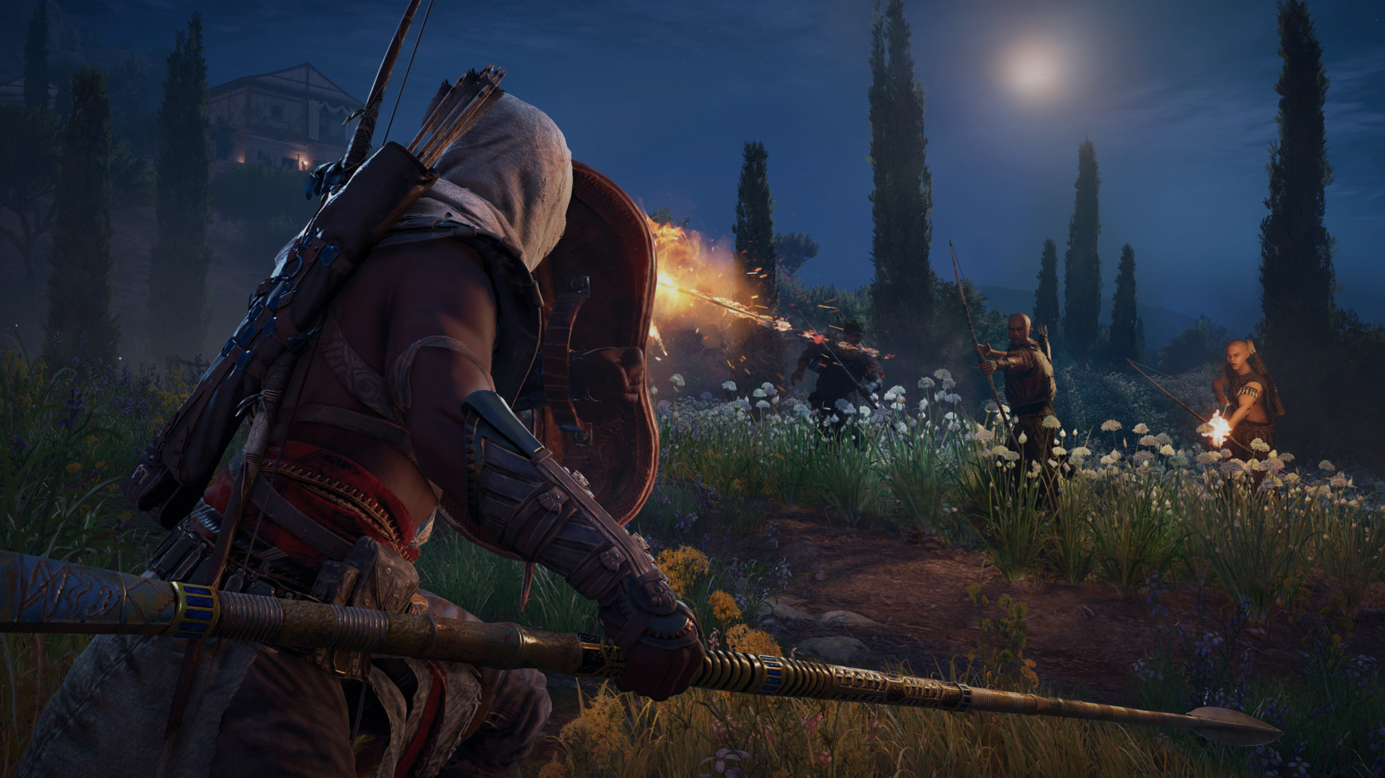
SINGLE-PLAYER

Slide 16
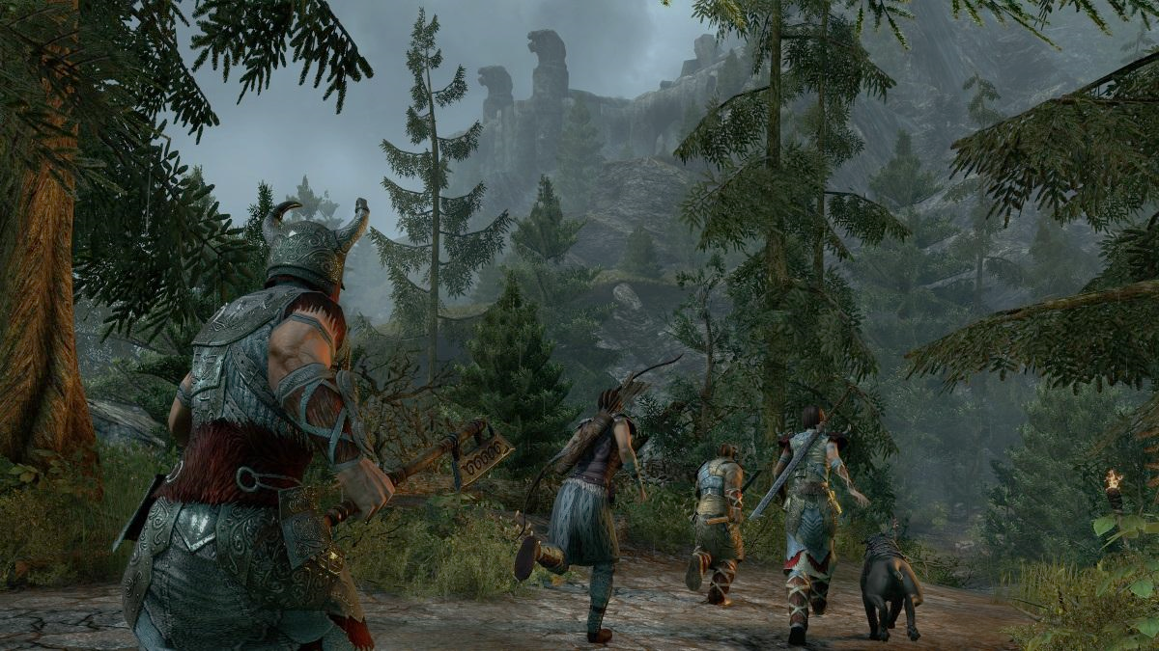
Story mode
Main quest
Sub quest

Slide 17
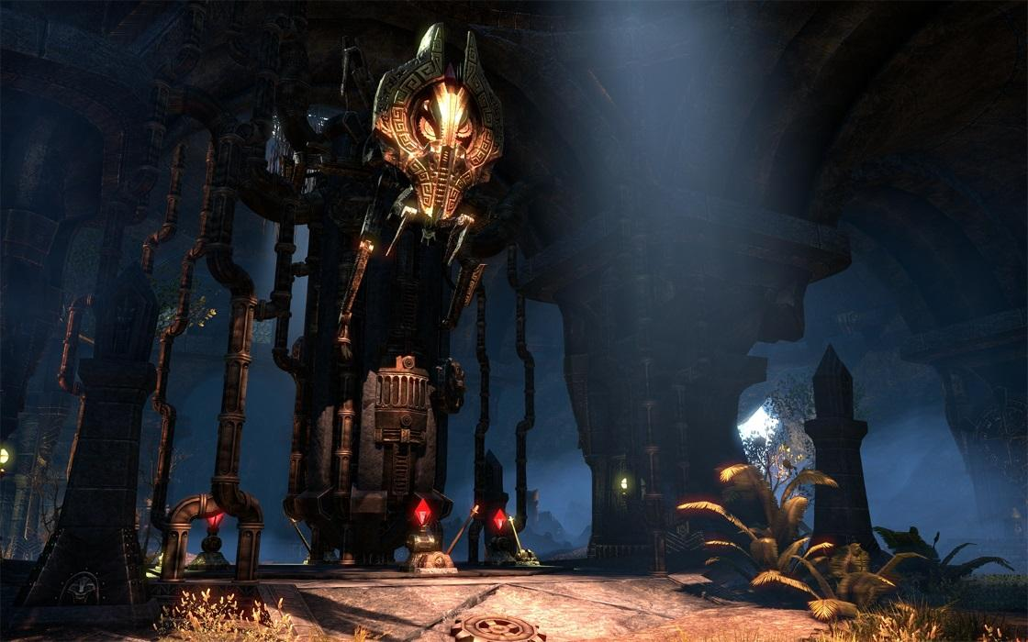
Exploration
Dungeons
regions

Slide 18
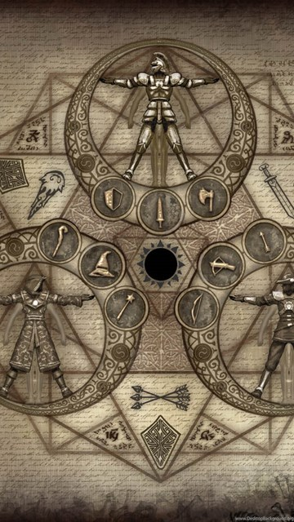
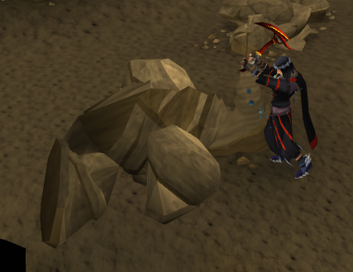
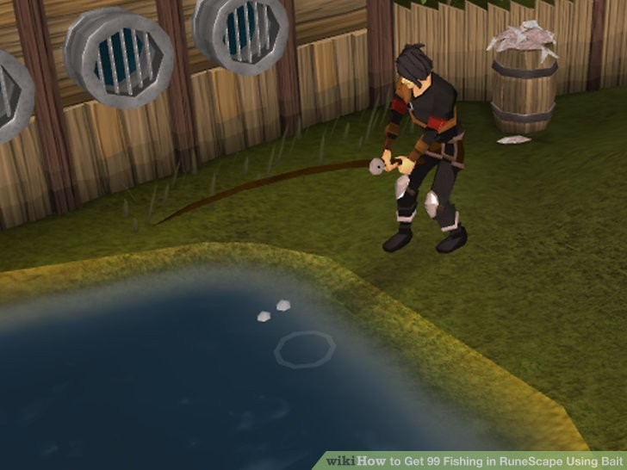
Resource gathering
Skilling
Combat
Non combat

Slide 19
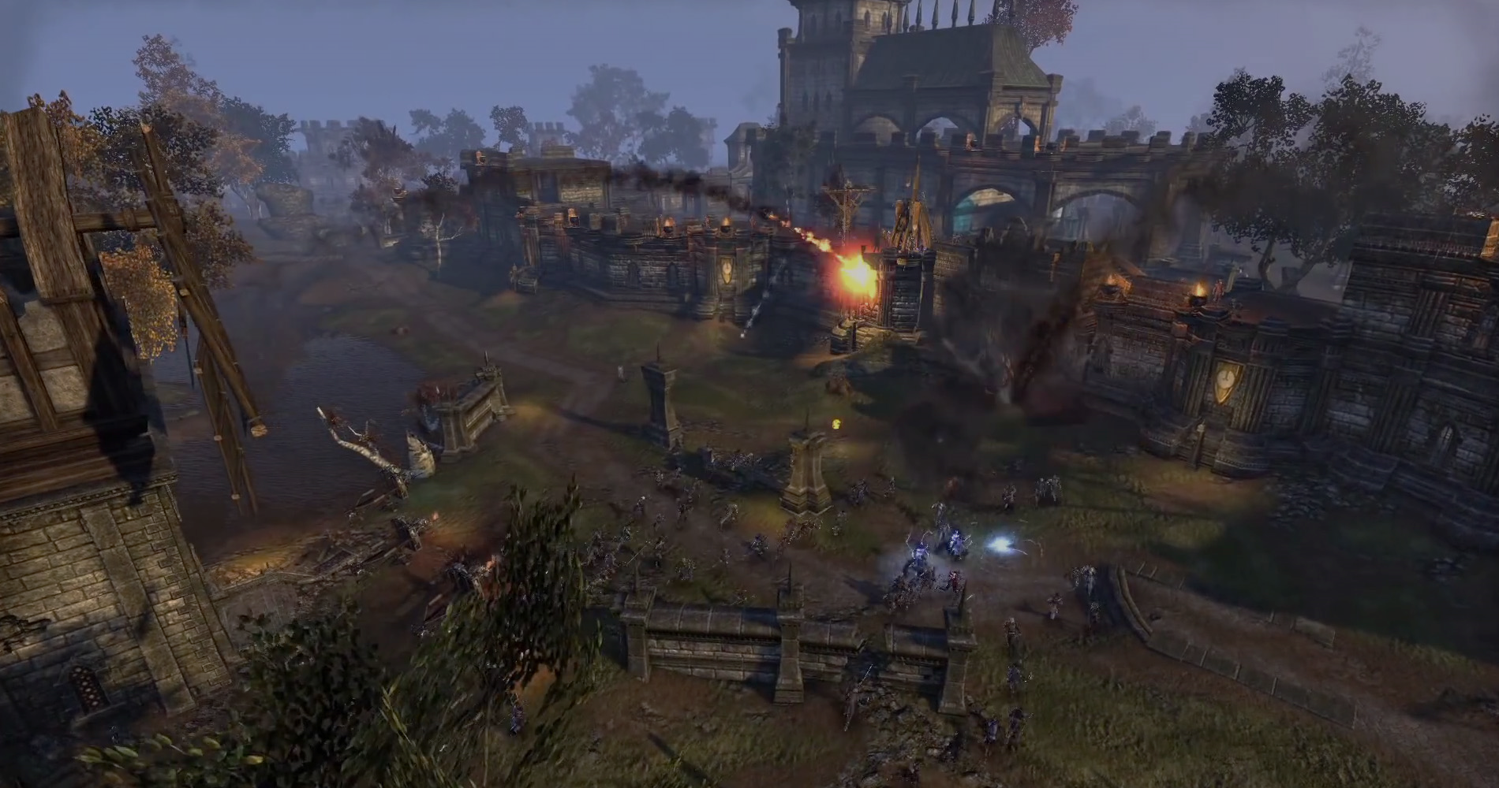
ONLINE MULTI-PLAYER

Slide 20
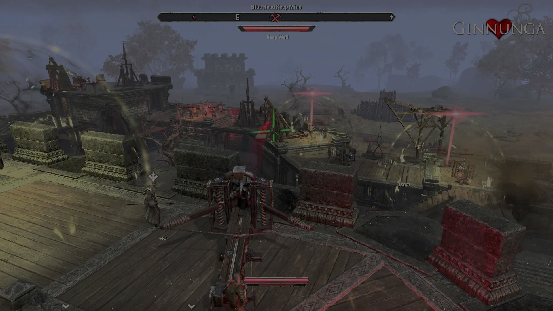
Conquer the castle
Similar to ESO
BATTLE ENEMIES
BATTLE PLAYERS
DESTOY FORTS
CLAIM THE THROWN

Slide 21
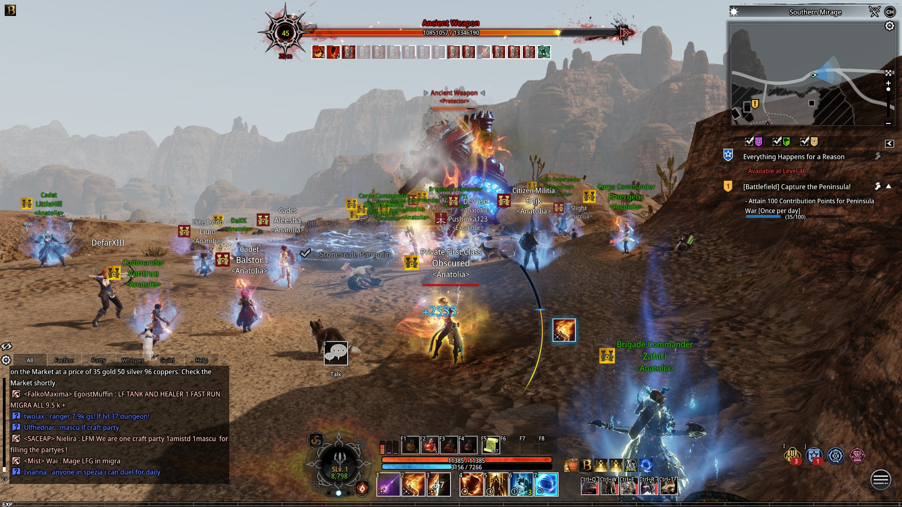
World bosses
Similar to bless online
Minimum 100 players
Work together to defeat
Earn in game prizes

Slide 22
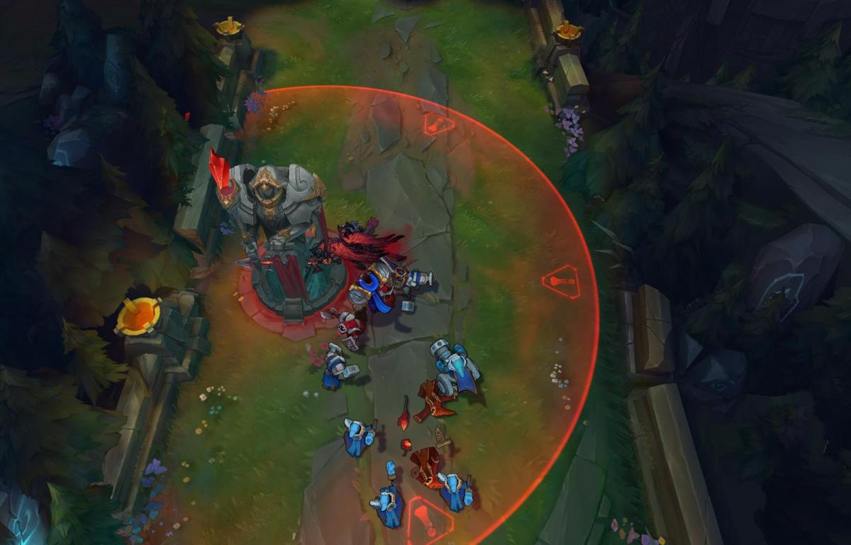
Destroy and conquer
Similar to lol
5 vs 5 * 4
Destroy structure
Battle enemies
Last one standing wins

Slide 23






PLATFORM

Slide 24

Development Time
Development will take 5 years
A total over 300 staff required
150 million investment needed.
Projected sales : 1/2 million copies
Projected price : $64.99 USD

Slide 25

Summary
SINGLE-PLAYER
CO-OPERATIVE MULTIPLAYER MODES
COSTUMIZABLE CHARACTERS
INTERESTING STORY

Slide 26



